Slide 1
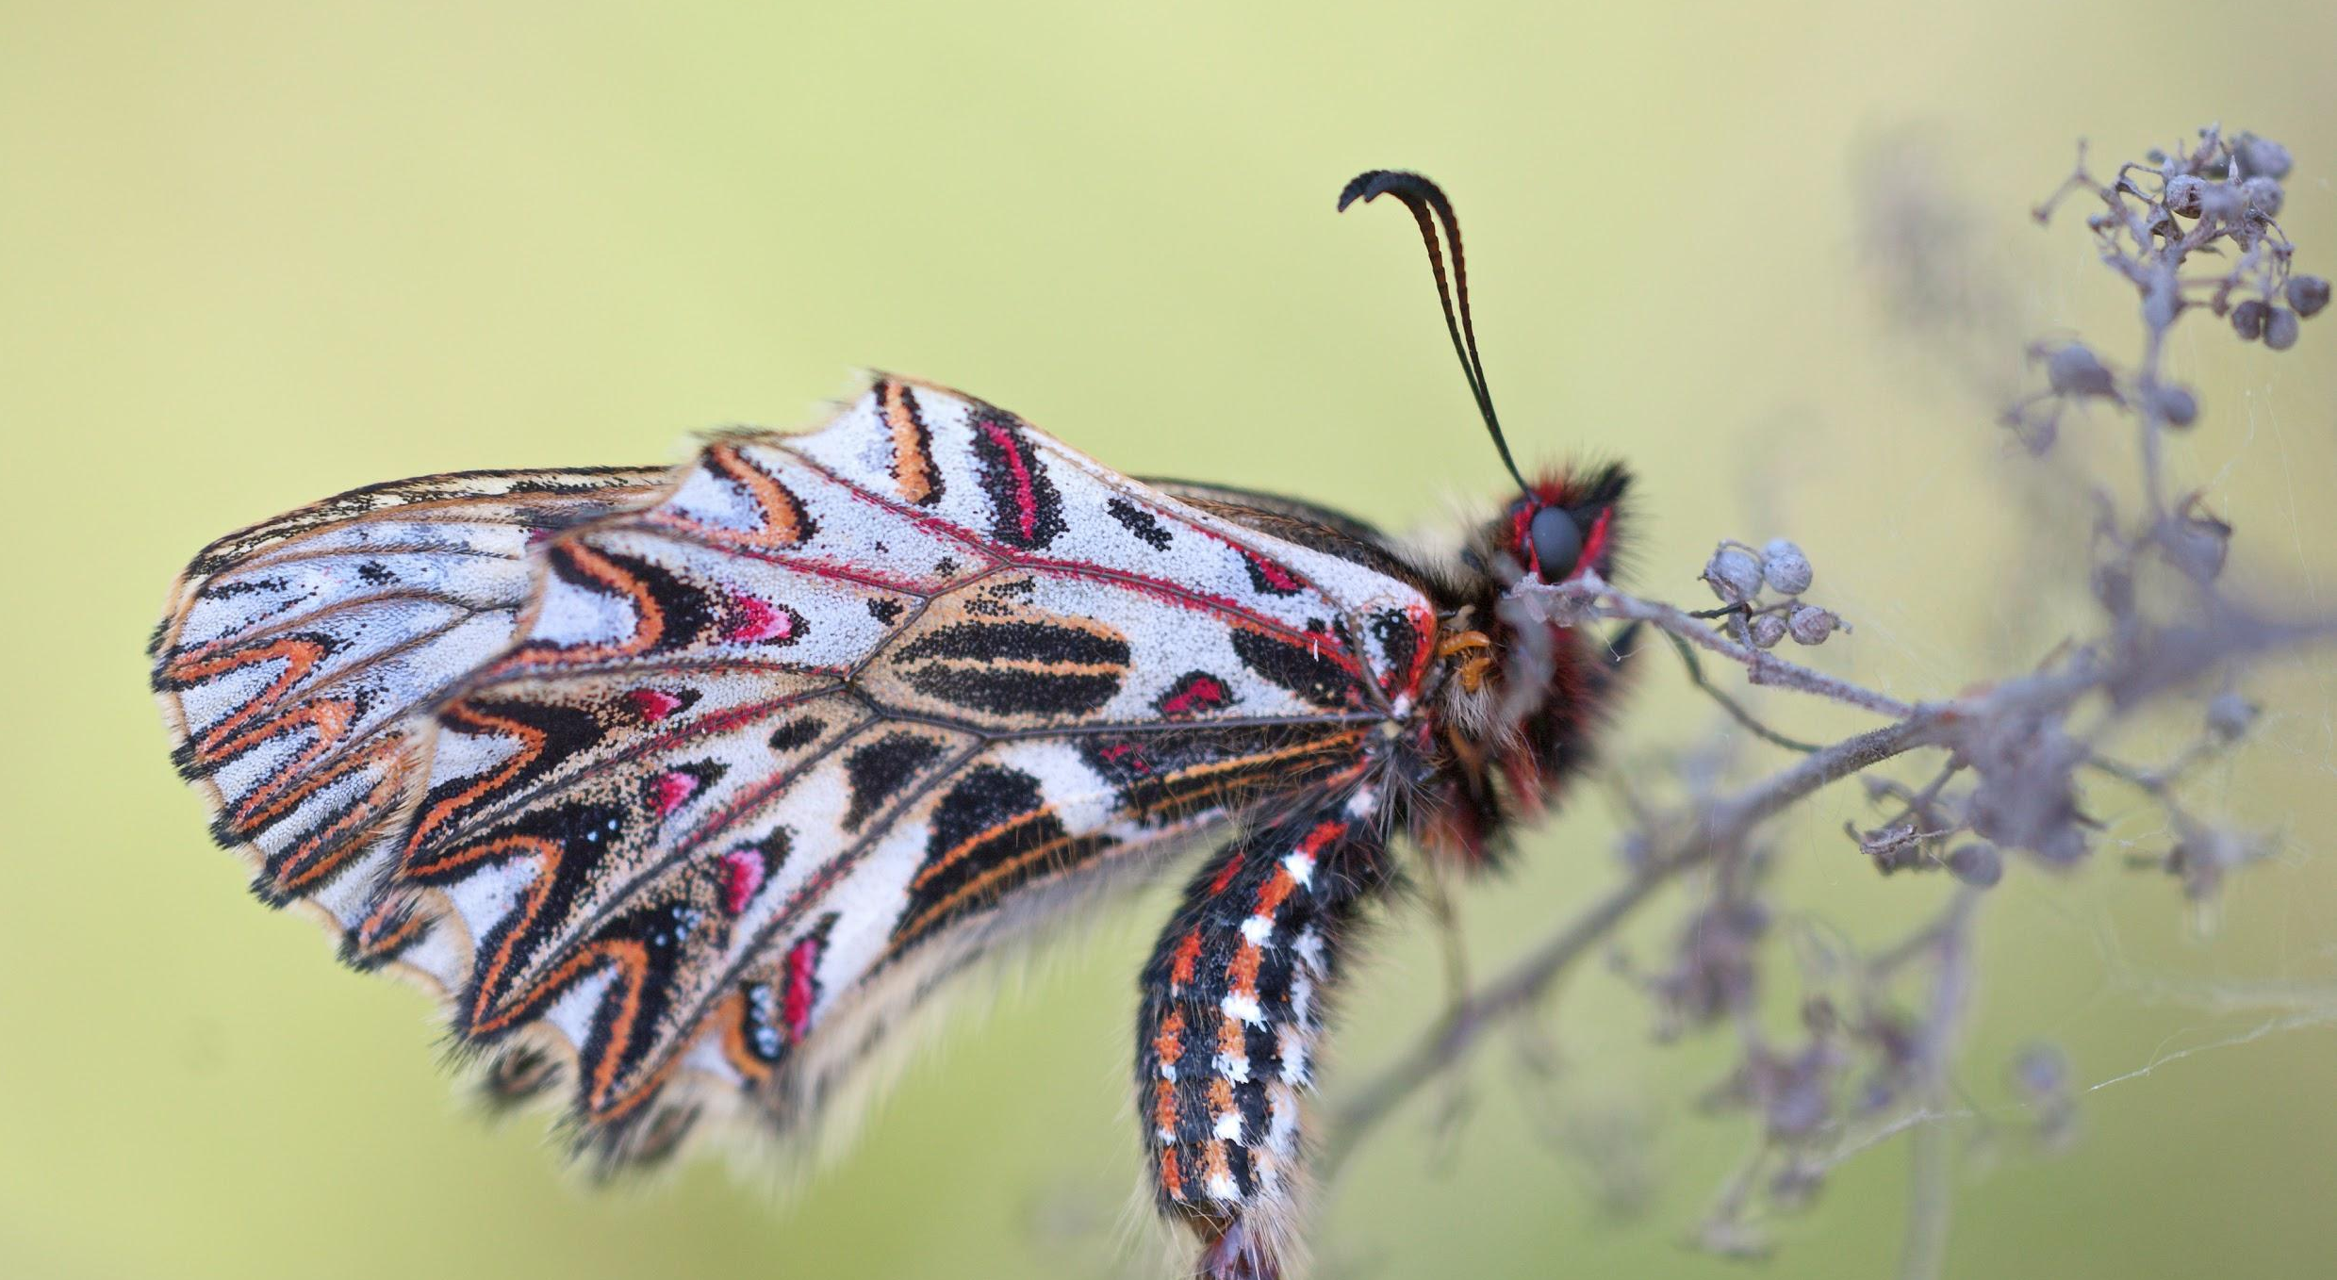
INVERTEBRATES
We will identify observable features of invertebrates
Notes:
Insert cover image and use transparency settings to fade image.

Slide 2
Do not delete this slide.
This slide is designed so that you can copy the prompt box you need and insert it into your slides.
This slide is hidden and will not be included when presenting your lesson.
TRACK WITH ME
VOCABULARY
1 -
HINT
Students, remember….
CHECK FOR UNDERSTANDING
READ WITH ME
TEACHER CUE
MAKE THE CONNECTION
Students, you already know….
EXTENSION
GESTURE WITH ME

Slide 3

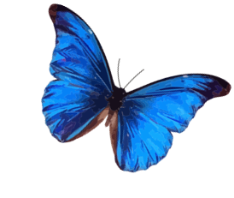
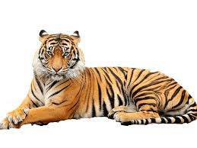
List the observable features of the tiger and butterfly.
Tiger:
Butterfly:

Slide 4
Is a butterfly living, non-living or dead?
Explain your answer using MRSGRENC
Move
Reproduce
Sensitive
Grow
Respire
Excrete₁ wastes
Nutrition
Cells

Slide 5
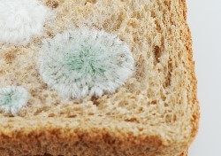
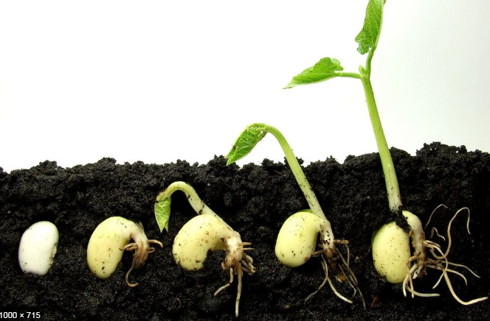
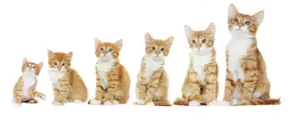
What is an example of growth?
M
R
S
Grow
R
E
N
C

Slide 6
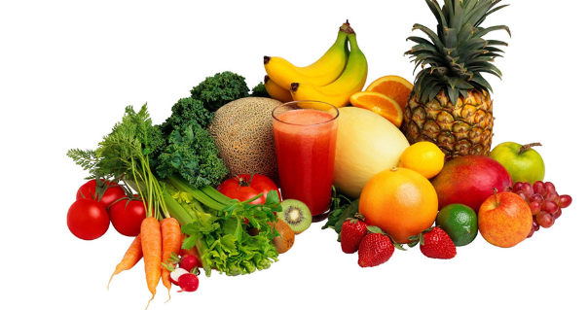
What is nutrition?
M
R
S
G
R
E
Nutrition
C

Slide 7
We will identify observable features of invertebrates.
TRACK WITH ME
READ WITH ME
We will define an invertebrate.
We will list observable features of different invertebrates.
We will give observable features to classify invertebrates.
DECLARE THE OBJECTIVE
Read the learning objective to your partner.
Notes:
Learning Objectives contain concepts (nouns, big ideas), skills (verbs, measurable behaviours) and sometimes context (restricting or targeting conditions).
●Example: Students will be able to describe the concept of density and apply it to floating and sinking.
●
Success criteria are specific measurable outcomes that if met mean that the student has met the learning objective.
Examples:
•Students will be able to compare densities of substances using mass and volume.
•Students will be able to identify whether a solid or liquid will float or sink in a liquid based on their densities.

Slide 8
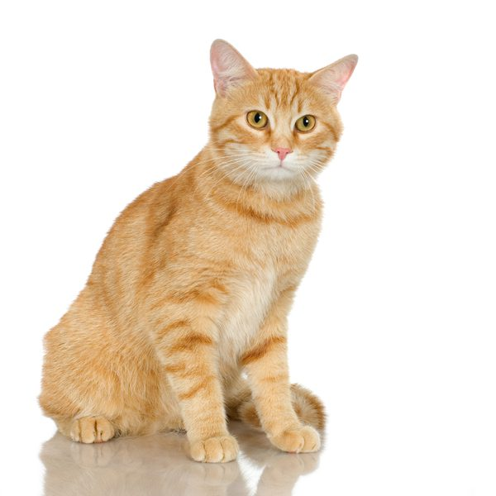
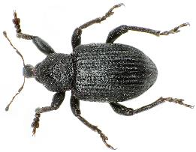
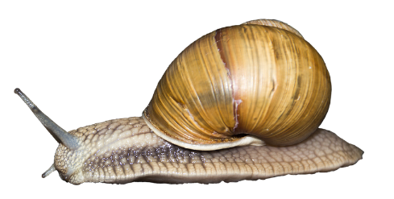
We will identify observable features of invertebrates.
Classification is a system of sorting organisms such as plants and animals into different groups based on observable features.
What is one observable difference between the cat, snail and beetle below?
MAKE THE CONNECTION
Students, you already know…. Observable features are what a plant or animal looks like. They are used to group animals into similar groups. Snails have shells, beatles have 6 legs and cats have fur.

Slide 9
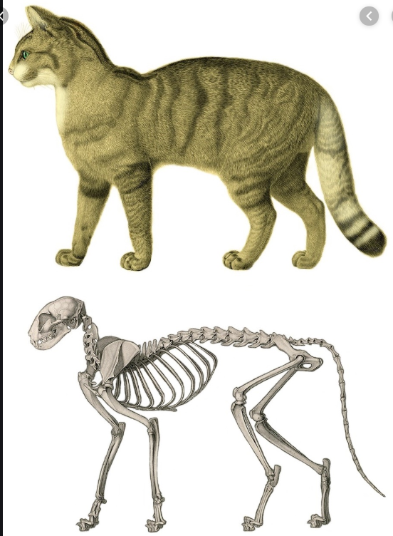
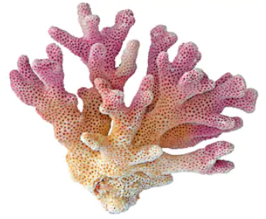
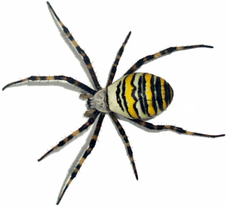
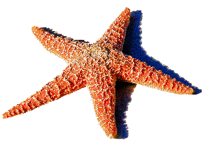
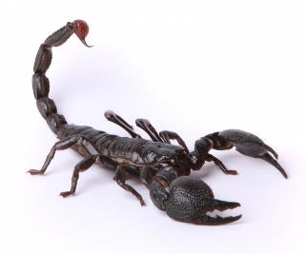
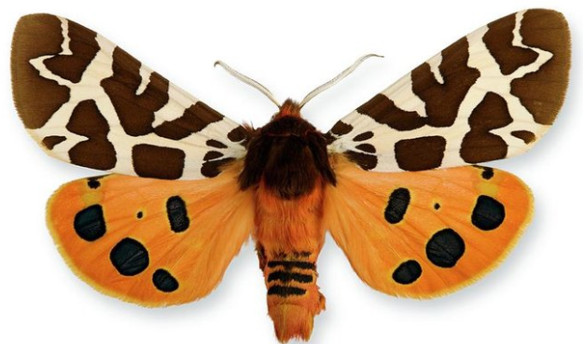
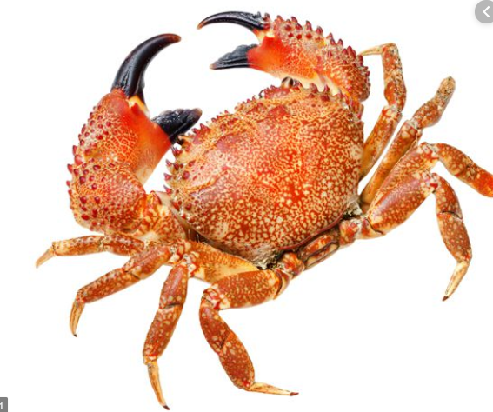
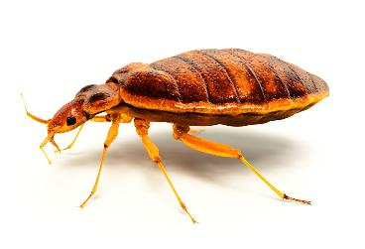
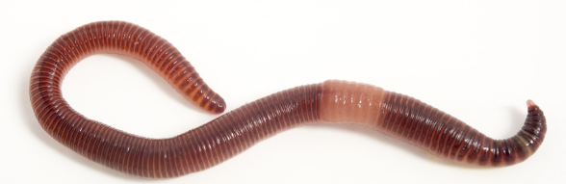
We will identify observable features of invertebrates.
Invertebrates are animals that do not have a skeleton or a backbone inside their body. This makes their observable features very diverse₁.
97% of animals on Earth are invertebrates. They live in the ocean, in the ground and on the land.
CHECK FOR UNDERSTANDING
Is this cat below an invertebrate? Explain your answer.
VOCABULARY
1 - different looking

Slide 10
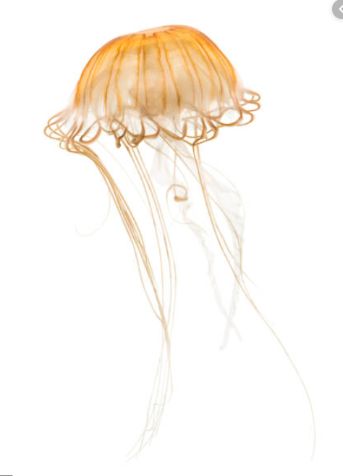
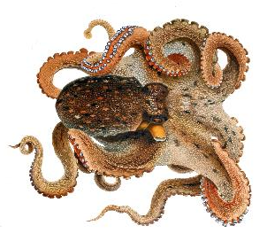
We will identify observable features of invertebrates.
Some invertebrates have the observable features of a soft and movable body. They can live in the water or under the ground in soil.
Worms, octopus and jellyfish are examples of invertebrates with soft bodies. They don’t need a skeleton to survive.
Jellyfish and octopus have tentacles to protect them from other animals. Worms move easier through soil.
CHECK FOR UNDERSTANDING
What is one observable feature the animals below have in common?
Jellyfish
Earthworm
Octopus

Slide 11
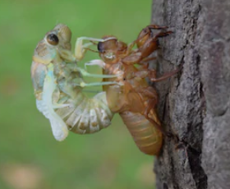
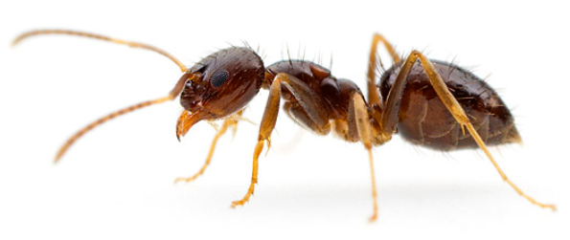
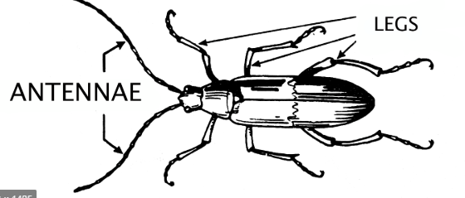
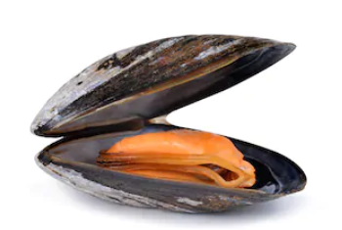
We will identify observable features of invertebrates.
CHECK FOR UNDERSTANDING
What observable features does this ant have?
Some invertebrates don’t have soft movable bodies. They have special external₁ features to give them protection and support.
Observable feature | Definition | Invertebrates with this feature
Exoskeleton | A hard body covering | Beatles, ants, spiders, grasshoppers, prawns, starfish and butterflies
Shell | A type of exoskeleton | Snails, crabs, clams and mussels
Antennae | Paired feelers on animal’s heads | crabs, ants, butterflies, crickets
Claws | Hooked structures on animal’s legs | Scorpions, beetles, crabs
VOCABULARY
1 - outside of the body

Slide 12
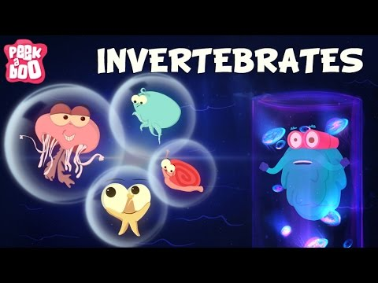
We will identify observable features of invertebrates.
CHECK FOR UNDERSTANDING
List one observable feature of three invertebrates in the video. 1. 2. 3.

Slide 13
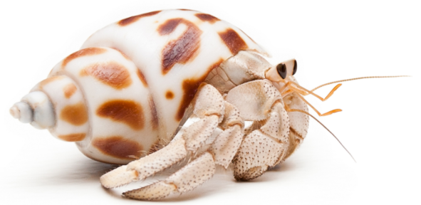
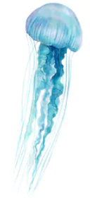
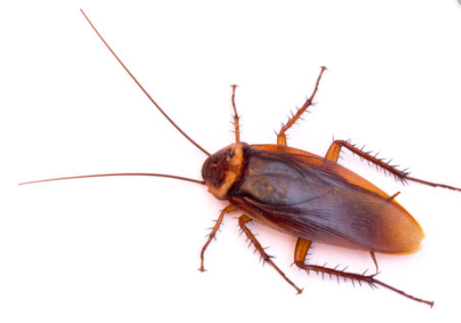
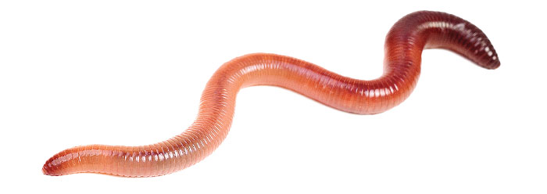
We will identify observable features of invertebrates.
CHECK FOR UNDERSTANDING
Can more than one feature be used for each invertebrate?
Match the observable features to the invertebrates below.
Observable features
Exoskeleton
Shell
Antennae
Soft body
Tentacles
A: Hermit crab
D: Beatle
HINT
Observable feature | Definition
Soft body | A body with no exoskeleton
Tentacles | Used to protect animals
Exoskeleton | A hard body covering
Shell | A type of exoskeleton
Antennae | Paired feelers on animal’s heads
Claws | Hooked structures on animal’s legs
B: Cockroach
E: Jellyfish
C: Worm

Slide 14
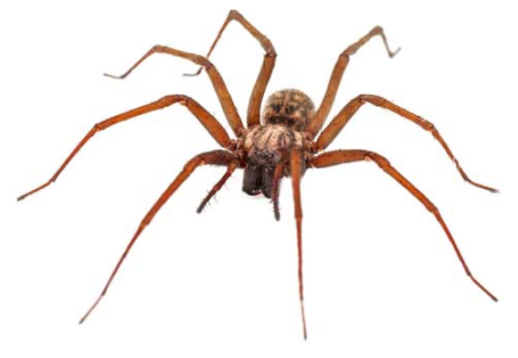
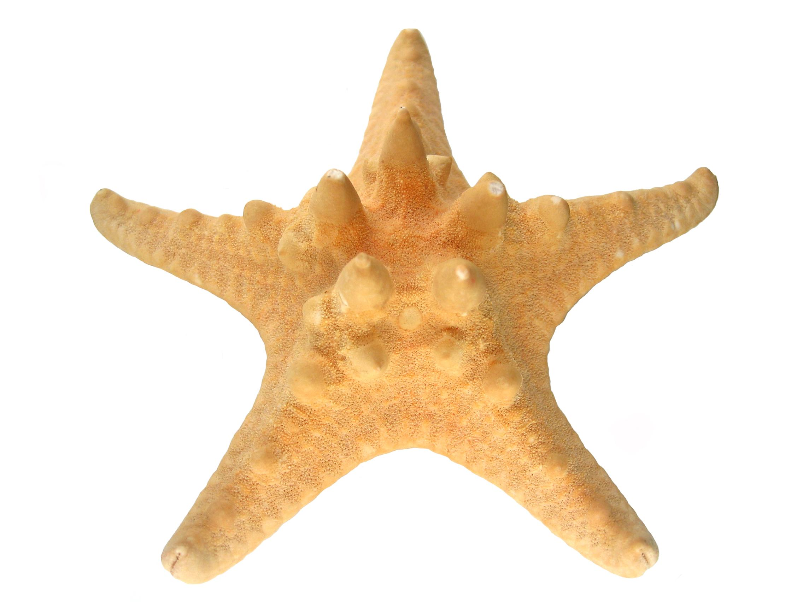
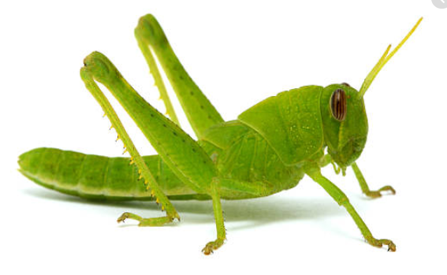
1
We will identify observable features of invertebrates.
Classify the following animals with the observable features below.
2
3
Observable feature | Definition | Invertebrates with this feature
Soft body | A body with no exoskeleton | 5,
Tentacles | Used to protect animals
Exoskeleton | A hard body covering
Shell | A type of exoskeleton
Antennae | Paired feelers on animal’s heads
Claws | Hooked structures on animal’s legs
5
4
7
6
8
9
10
11

Slide 15
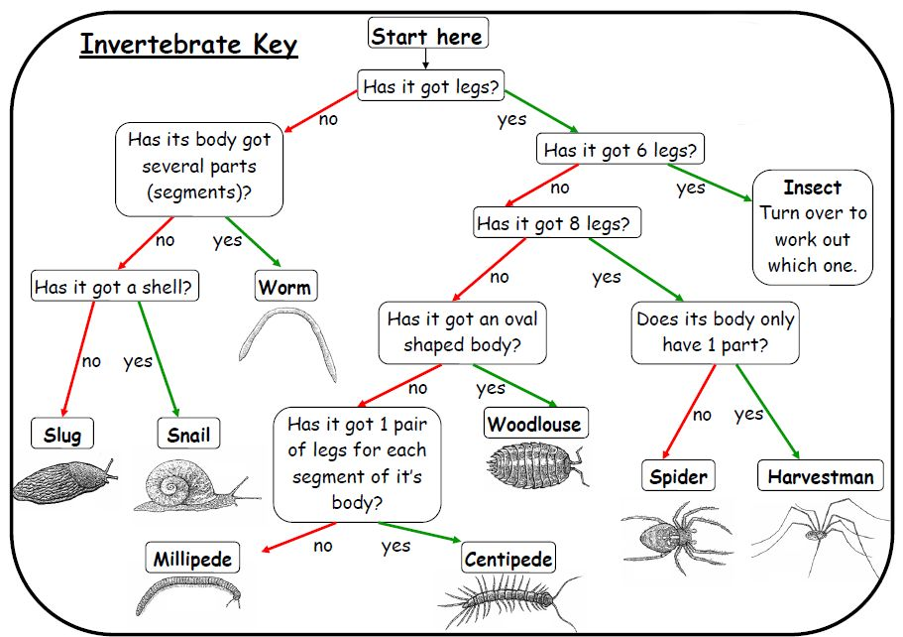
We will identify observable features of invertebrates.
97% of animals on Earth are invertebrates. They live in the ocean, in the ground and on the land.
You will need to create keys to classify (group) animals using the observable features of invertebrates.
CHECK FOR UNDERSTANDING
Why do you need to know the observable features of invertebrates?

Slide 16
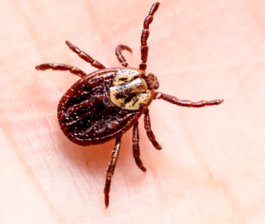
We will identify observable features of invertebrates.
Invertebrates are animals that do not have a skeleton or a backbone inside their body. This makes their observable features very diverse.
Observable feature | Definition | Invertebrates with this feature
Soft body | A body with no exoskeleton | Worms, jellyfish, octopus
Tentacles | Used to protect animals | Jellyfish, octopus, squid
Exoskeleton | A hard body covering | Beatles, ants, spiders, grasshoppers, prawns, starfish and butterflies
Shell | A type of exoskeleton | Snails, crabs, clams and mussels
Antennae | Paired feelers on animal’s heads | crabs, ants, butterflies, crickets
Claws | Hooked structures on animal’s legs | Scorpions, beetles, crabs
CHECK FOR UNDERSTANDING
This is a tick, Do you think it is an invertebrate? Justify your answer using observable features.

Slide 17
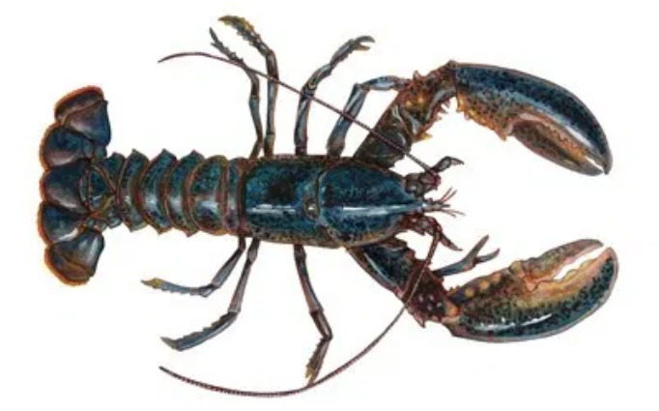
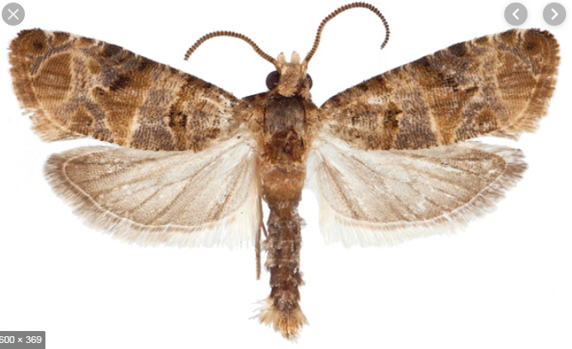
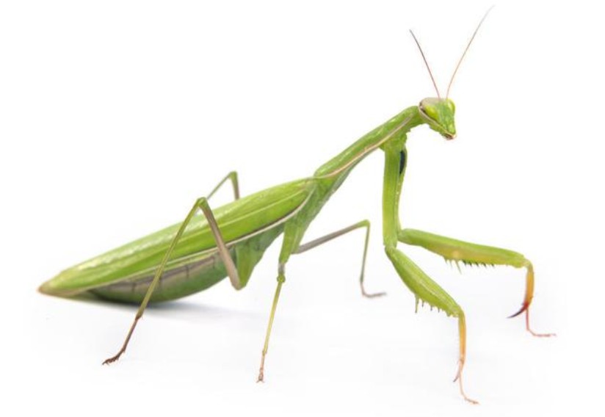
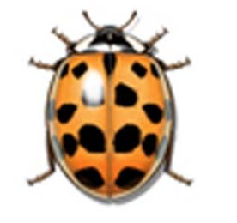
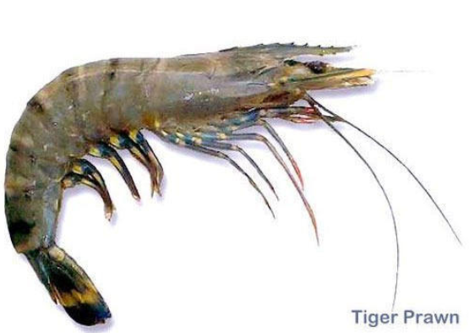
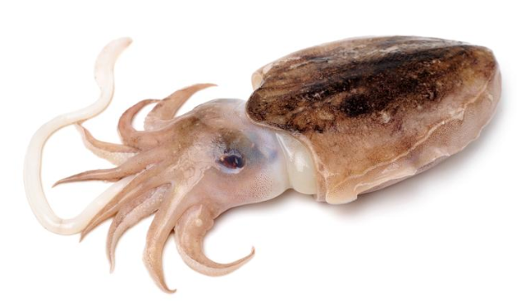
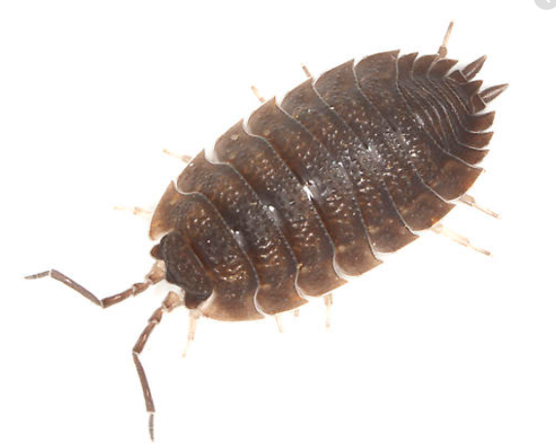
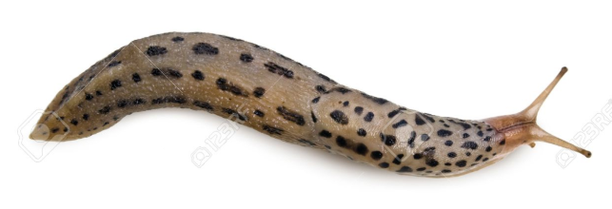
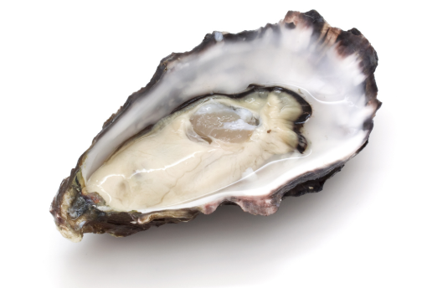
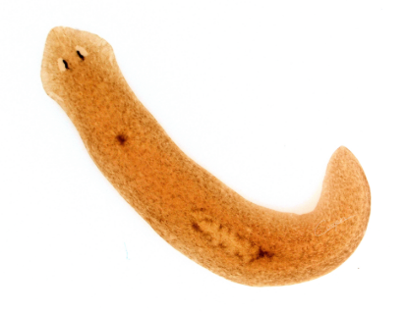
We will identify observable features of invertebrates.
1
Classify the following animals with the observable features below.
2
Observable feature | Definition | Invertebrates with this feature
Soft body | A body with no exoskeleton
Tentacles | Used to protect animals
Exoskeleton | A hard body covering
Shell | A type of exoskeleton
Antennae | Paired feelers on animal’s heads
Claws | Hooked structures on animal’s legs
3
4
5
6
7
8
9
10
Notes:
Please include tasks/questions here rather than just referring to a worksheet. This will save on photocopying and facilitate sharing with other schools.
Try and build tasks/questions which escalate through Bloom’s Taxonomy. This will help with differentiation.

Slide 18
We will identify observable features of invertebrates.
We will define an invertebrate.
We will list observable features of different invertebrates.
We will give observable features to classify invertebrates.
CHECK FOR UNDERSTANDING
Check Success Criteria.

Slide 19
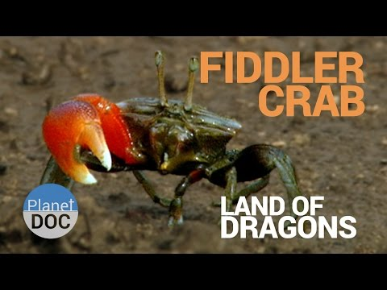
We will identify observable features of invertebrates.
CHECK FOR UNDERSTANDING
What are the 2 things that male Fiddler Crabs use their claws for? 1. 2. 3.

